Slide 1
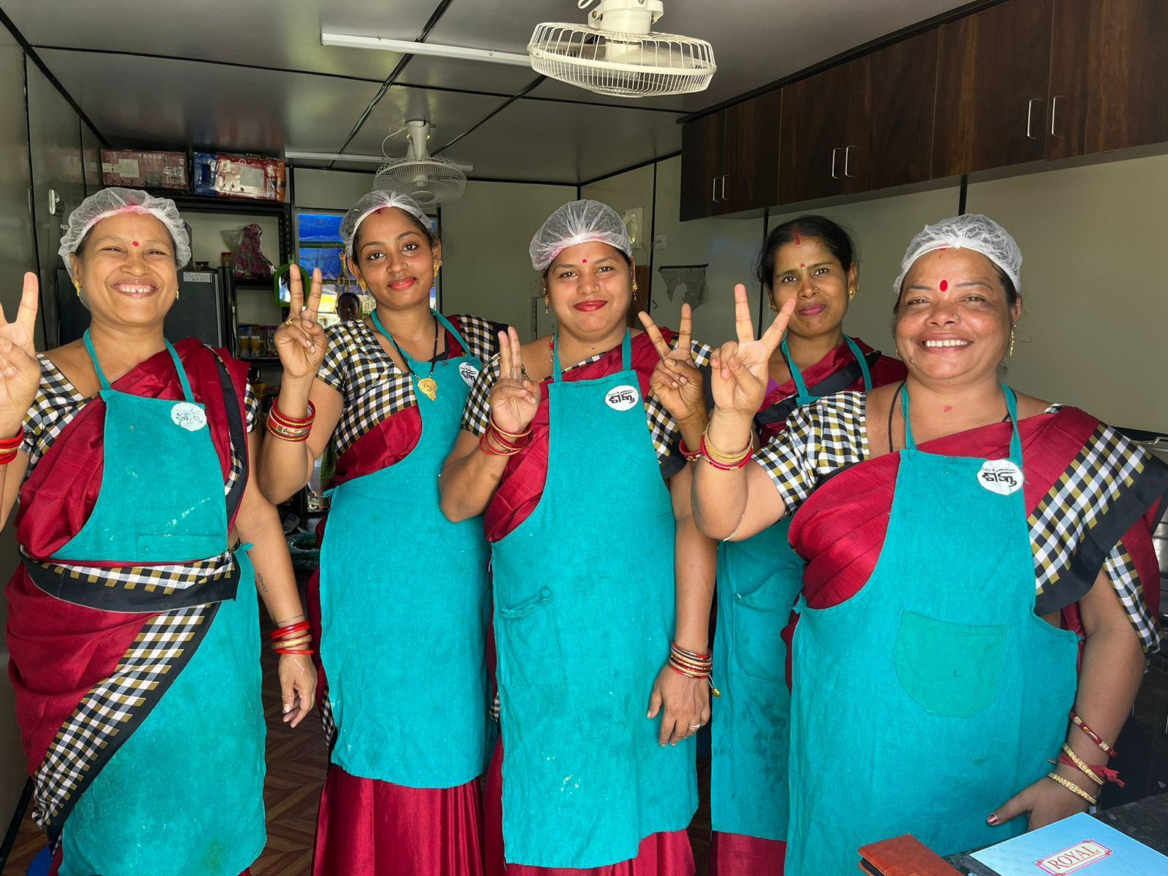


PREPARATION OF A BUSINESS PLAN
November 30,2023

Slide 2

FAILING TO PLAN IS PLANNING TO FAIL

Slide 3
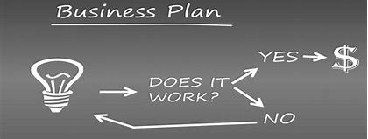


BUSINESS PLAN HELPS
Decide | Organize | Present
If you should start your business or not | Your ideas so that you will see how to start and run your business in the best possible way | To a government department or lending institution to obtain a loan/ investors etc

Slide 4
OUTLINE OF A BUSINESS PLAN
Introduction
Opportunity
Market Analysis & Competitor analysis
Business Model
Marketing Plan
Operational Plan
Risk factors / Uncertainties and Mitigation strategies
Entrepreneurial Background
Financial projections
Appendix (exhibits)

Slide 5






1.Introduction
Basic background
Business & objectives
Major products and services to be offered
Location
Owner background details
Any other points relevant

Slide 6
2. THE OPPORTUNITY
what is the need / pain – how strong is the pain
who has it (define your customer)
why will they pay for it?
Have you have sensed or experienced a real problem, that’s an opportunity !
Your solution
how will you fulfill this need (define your product)
what value are you adding

Slide 7
3. THE MARKET -DESCRIBE THE MARKET OR THE CUSTOMERS YOU WILL SERVE
What industry are you competing
Customer Segment – needs of each set of customers
Product for each segment
size
trends
Past growth rate ; past 1/2/3 years
Projected growth rate over the next 6m / 1 / 5 /10 years

Slide 8
COMPETITION
Who are the current competitors
What resources do they control, what are their strengths and weaknesses
How will they respond to us & how can we respond to their response
Name of competitor | Location | Products/ services offered | Estimated Turnover | Pricing | Differentiation with others | Comments

Slide 9
4. BUSINESS MODEL
What is the business – in details
how will you make money. List all the sources of revenue
What are the Capital costs – fixed and working capital
Sources of financing

Slide 10
CAPITAL COSTS
Fixed Capital
Assets | No of units | Per unit costs | Total costs per asset
Fixed assets
Others
Working capital required for business for ONE/ TWO MONTHS
Raw material required + WIP + Finished goods + Debtors
Others fixed costs
Fixed Capital
Working capital
Total Capital

Slide 11
SOURCE OF CAPITAL
Source | Details | Amount
Investment by owner
Bank Loan | Bank name
Loan from family | Details
Loan from other sources | Details
 | Total

Slide 12
5. MARKETING PLAN
Overall question to consider (business strategy)
competing on price
quality
niche (differentiation)
This influences (the classic 4 p’s)
product
Placement – location
price
Promotion

Slide 13






6. OPERATIONS
How will you put your plan into action
Understand the key activities that are necessary for your business to succeed
Core elements of your operation : production, distribution, sales & marketing
Facilities and operations required to house and coordinate your plan
Manage relations w/ suppliers, partners and customers
Understand government regulations / licensing
Schedule – Pre inception/ 1-2/ 3-6/6-12/12-24/24-36 months

Slide 14
7. RISK FACTORS & UNCERTAINTY
ALL opportunities are subject to CONSIDRIBLE risk
What can go wrong w/ your idea
How likely is it going to go wrong
How can you manage these

Slide 15



8. ENTREPRENEUR’S BACKGROUND
Team members
Background
Prior experience
Key capabilities (tech, marketing, ops, finance, contacts)
Training attended

Slide 16
9. FINANCE STATEMENTS
Summary of financial requirements to be captured
Revenues projections for the first three years
Cash flows for the first three years
Balance sheet
Break even point

Slide 17
 | Year 1 | Year 2 | Year 3
Revenues
Revenue from cash sales
Revenue from credit sales
Total Revenue
COGS/ Direct costs
Cost of raw materials
Cost of transporting raw material from the market
Cost of packing materials
Cost of production labour
Total Direct costs
Gross profit (Total Revenue - Total Direct costs)
Indirect costs
Selling and admin expense
Utilities - rent etc
Interest paid on loan
Depreciation
Total Indirect costs
Net Profit (Gross Profit - Total Indirect Costs)
Net Profitability (Net profit/ Revenue)

Slide 18
Cash Flow Statement | Year 1 | Year 2 | Year 3
Cash at the beginning of month
Cash Inflow
Cash sales
Credit sales, collection from debtors
Loan received
Total Inflow
Cash Outflow
Raw materials
Wages
Equipments
Loan repayment
Others
Total outflow
Cash at the end of Month

Slide 19
 | Year 1 | Year 2 | `Year 3
Owners' Equity Invested capital
Retained earnings
Total Owners' Equity
Current Liabilities Accounts payable
Interest payable
Other current liabilities
Total Current Liabilities
Long-term Debt Bank loans payable
Other long term debt
Total Long-term Debt
Total Liabilities
Current Assets Cash in bank
Accounts receivable
Inventory
Other current assets
Total Current Assets
Fixed Assets Machinery & equipment
Furniture & fixtures
Land & buildings
Other fixed assets
Total Fixed Assets (net of depreciation)
TOTAL Assets

Slide 20
10. APPENDICES
Include market data, from surveys, articles, and any primary or secondary research
tables
pictures
graphics
charts

Slide 21
BUSINESS PLAN MODEL PRESENTATION & DISCUSSION

Slide 22


Slide 23
QUESTION ANSWER SESSION

Slide 24
Individual Assignment
Prepare a business plan for your idea.

Slide 25
Summary

